Slide 1

ARTIFICIAL INTELLIGENCE AND NEURAL NETWORKS
SETTING THE STAGE
data-action-lab.com

Slide 2
OUTLINE
A Brief History of A.I.
Basics of Neural Networks
Case Study: Japanese Pharmacy Chain
Deep Learning

Slide 3
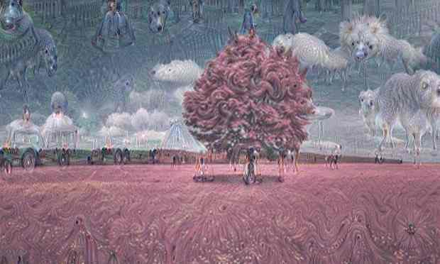
[Yes, Androids Do Dream of Electric Sheep, The Guardian UK]

Slide 4
Headlines
“AlphaGo vanquishes world’s top Go player, marking A.I.’s superiority over human mind” [South China Morning Post, May 27, 2017]
“A Japanese A.I. program just wrote a short novel, and it almost won a literary prize” [Digital Trends, March 23, 2016]
“Elon Musk: Artificial intelligence may spark World War III” [CNET, September 4, 2017]
“A.I. hype has peaked so what’s next?” [TechCrunch, September 30, 2017]

Slide 5
Q: How many legs does a cat have if you call the tail a leg?
A: Four. Calling the tail a leg doesn’t make it a leg.
(old riddle, attributed to Abraham Lincoln)

Slide 6
What is Artificial Intelligence (A.I.)?
[D. Hoftsadter, Gödel, Escher, Bach, 1979]
What are the essential qualities and skills of an intelligence?
provides flexible responses in various scenarios
takes advantage of lucky circumstances
makes sense out of contradictory messages
recognizes the relative importance of a situation’s elements
finds similarities between different situations
draws distinctions between similar situations
comes up with new ideas from scratch or by re-arranging previous known concepts

Slide 7
What is Artificial Intelligence?
[Artificial Intelligence, Wikipedia]
A.I. research is defined as the study of intelligent agents: any device that perceives its environment and takes actions that maximize its chance of success at some goal.
Examples
Expert Systems
TurboTax, WebMD, technical support, insurance claim processing, air traffic control, etc.
Decision-Making
Deep Blue, auto-pilot systems, ”smart” meters, etc.
Natural Language Proc.
machine translation, Siri, named-entity recognition, etc.
Recommenders
Google, Expedia, Facebook, LinkedIn, Netflix, Amazon, etc.
Content generators
music composer, novel writer, animation creator, etc.
Classifiers
facial recognition, object identification, fraud detection, etc.

Slide 8
Historical Timeline (TL;DR)
???
Deep Learning and Big Data
Initial Optimism
Revival
Modern A.I.
???
1st A.I. Winter
2nd A.I. Winter
1950s 1960s 1970s 1980s 1990s 2000s 2010s 2020s
Turing Test
5th Generation Project
Human Brain Project
???
Dartmouth Summer
Backpropagation
Deep Blue
Stanley

Slide 9
Neural Networks in a Nutshell
A trained Artificial Neural Network (ANN) is a function that maps inputs to outputs in a useful way:
receives input(s)
computes values
provides output(s)
ANNs use a Swiss-army-knife approach to things (plenty of options, but it’s not always clear which one should be used).
The user does not need to decide much about the function or know much about the problem space in advance (quiet model).

Slide 10
Neural Networks in a Nutshell
Algorithms allow ANNs to learn (i.e. generate the function and its internal values) automatically.
ANNs can be used for:
supervised learning (multi-layered feedforward neural networks)
unsupervised learning (self-organizing maps)
reinforcement learning.
Technically, the only requirement is the ability to minimize a cost function (optimization).

Slide 11
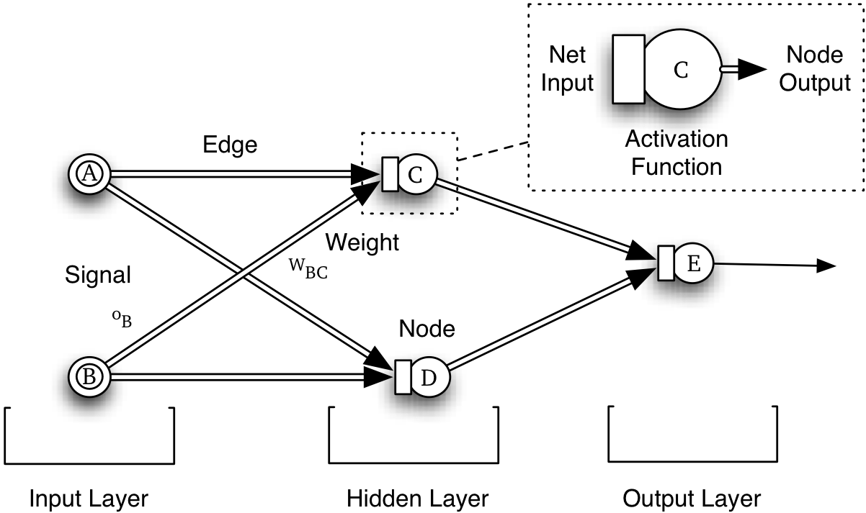





Network Topology and Terminology
Network Topology and Terminology
Net Input
Node Output
$$z$$
$$a(z)$$
Edge
Activation Node
Weight
Signal
$$w$$
$$x$$
Output
$$\hat{y}$$
Node
Input Layer
Hidden Layer(s)
Output Layer

Slide 12
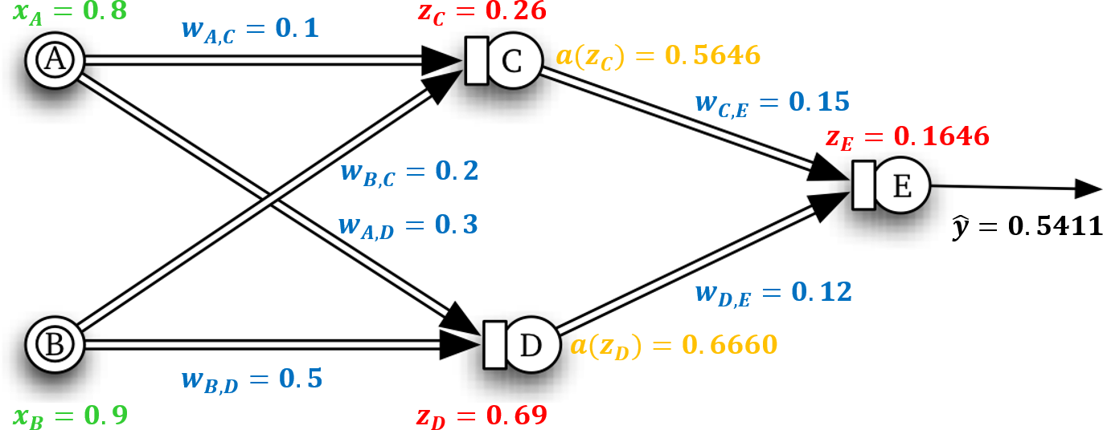


Feed Forward Network
Feed Forward Network
$$=x_{A}w_{A,C}+x_{B}w_{B,C}$$
$$=x_{A}w_{A,D}+x_{B}w_{B,D}$$

Slide 13
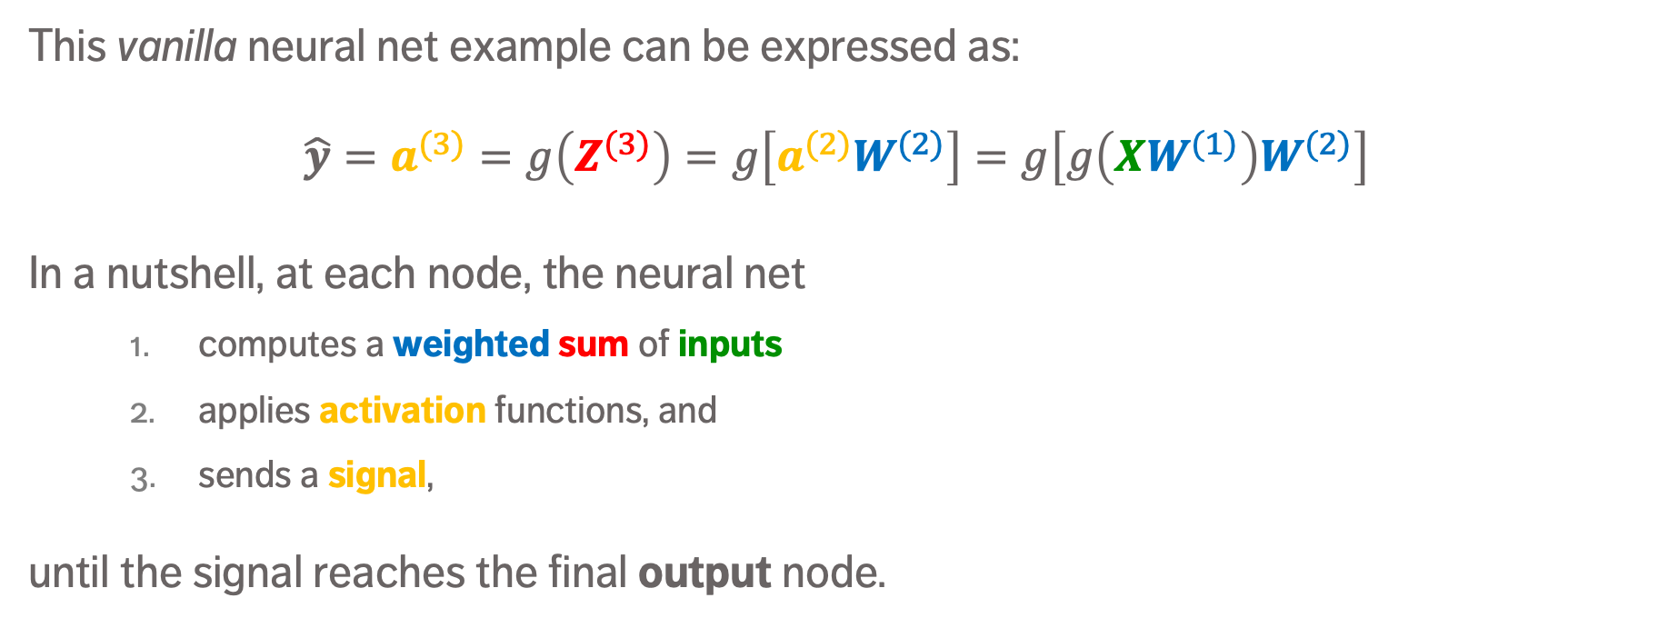
ANN in Matrix Notation
This vanilla neural net example can be expressed as:
$$\hat{y}=a^{(3)}=g\left(Z^{(3)}\right)=g\left[a^{(2)}W^{(2)}\right]=g\left[g\left(XW^{(1)}\right)W^{(2)}\right]$$
In a nutshell, at each node, the neural net
computes a weighted sum of inputs
applies activation functions, and
sends a signal,
until the signal reaches the final output node.

Slide 14
Backpropagation Objective

Slide 15
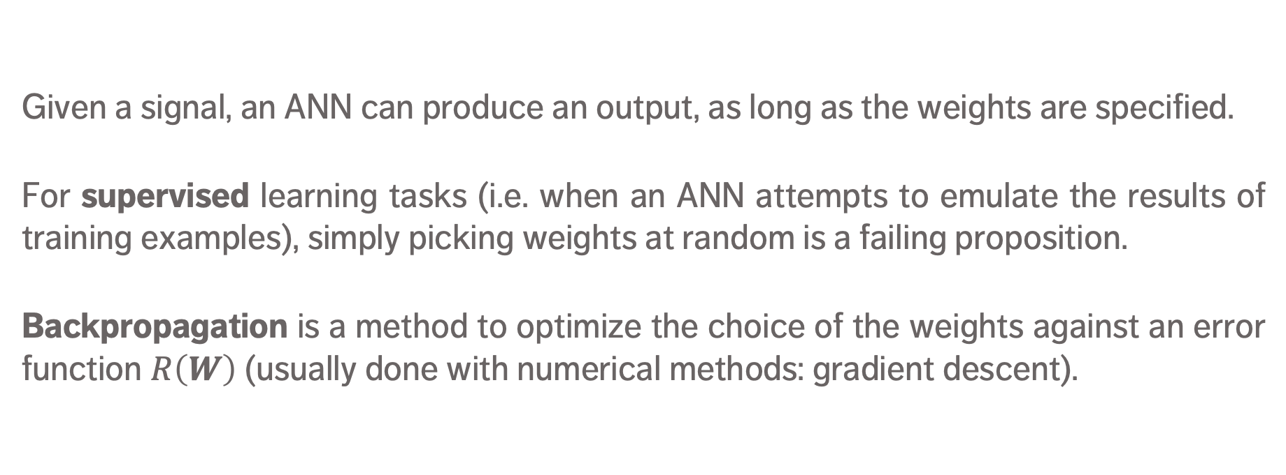
Backpropagation – ANN Training
Given a signal, an ANN can produce an output, as long as the weights are specified.
For supervised learning tasks (i.e. when an ANN attempts to emulate the results of training examples), simply picking weights at random is a failing proposition.
Backpropagation is a method to optimize the choice of the weights against an error function $R\left(W\right)$ (usually done with numerical methods: gradient descent).

Slide 16
Strengths
ANNs can be quite accurate when making predictions – better than other algorithms with a proper set up.
ANNs often work when other things fail:
when the relationship between attributes is complex
when there are a lot of dependencies/nonlinear relationships
messy, highly connected inputs (images, text and speech)
non-linear classification
ANNs are relatively easy to set up (with available packages).
ANNs degrade gracefully (important in robotics).

Slide 17
Limitations
ANNs are relatively slow (creating and using) and prone to overfitting (may require large/diverse training set).
ANNs usually do not provide good interpretation (unlike decision trees or logistic regression, say). Can you live with that?
No algorithms for selecting the optimal network topology.
Even when they do perform better than other options, ANNs may not perform that much better due to No Free-Lunch Theorems; and they’re susceptible to various forms of adversarial attacks.

Slide 18
DISCUSSION
The biggest challenge (to our minds) is to overcome the black box nature of ANNs. How important is it to you and your organization to be able to explain data-driven decisions?

Slide 19
Neural Networks VIDEOS (BRILLIANT!)
Neural Networks Demystified, Welch Labs https://www.youtube.com/watch?v=bxe2T-V8XRs (first in the series)
Learning to See, Welch Labs https://www.youtube.com/watch?v=i8D90DkCLhI (first in the series)
Neural Networks, 3 Blue 1 Brown https://www.3blue1brown.com/videos/2017/10/9/neural-network

Slide 20
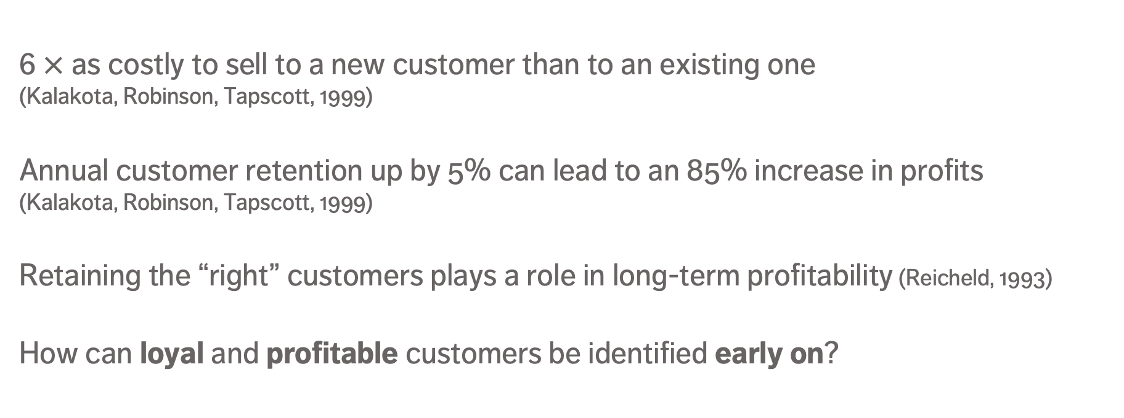
CASE STUDY: JAPANESE PHARMACY – Context
[A Neural Network Application to Identify High-Value Customers for a Large Retail Store in Japan, Ip,et al.]
6 $×$ as costly to sell to a new customer than to an existing one (Kalakota, Robinson, Tapscott, 1999)
Annual customer retention up by 5% can lead to an 85% increase in profits (Kalakota, Robinson, Tapscott, 1999)
Retaining the “right” customers plays a role in long-term profitability (Reicheld, 1993)
How can loyal and profitable customers be identified early on?

Slide 21
CASE STUDY: JAPANESE PHARMACY – LEARNING Flow
Fine-Tune Model
Training Data
Train Neural Network Model
Apply NN Model to Test Data
Assess NN Model Performance
Testing Data

Slide 22
CASE STUDY: JAPANESE PHARMACY – Data
114,069 customers who made purchases during a 1-yr period
Customer value measured using
frequency of visit (1 – 5 scale)
profitability per visit (1 – 5 scale)
High-value customers (HVC): (4,5), (5,4), (5,5), making up 10.6% of observations
HVCs generate 52.5% of profits, 38.4% of revenues

Slide 23
CASE STUDY: JAPANESE PHARMACY – Data
Target variable: customer value
Input variables: total number of categories purchased, profit per visit, # of units purchased per visit, # visits, purchase of:
All variables were scaled from 0 – 1:
paper product
detergent
eye drops
kitchen cleaner
bottled supplement
hair care products
fabric softener
household cleaner
toothpaste
cold medicine

Slide 24
CASE STUDY: JAPANESE PHARMACY – Data
Learning set: 104,069 observations (selected randomly)
Training/Testing set ratio: 70-to-30
Validation set: remaining 10,000 observations
Calibration metrics: predictive accuracy, overall accuracy
predictive accuracy = # correctly predicted HVCs / # HVCs
overall accuracy = # correctly predicted class / # customers

Slide 25
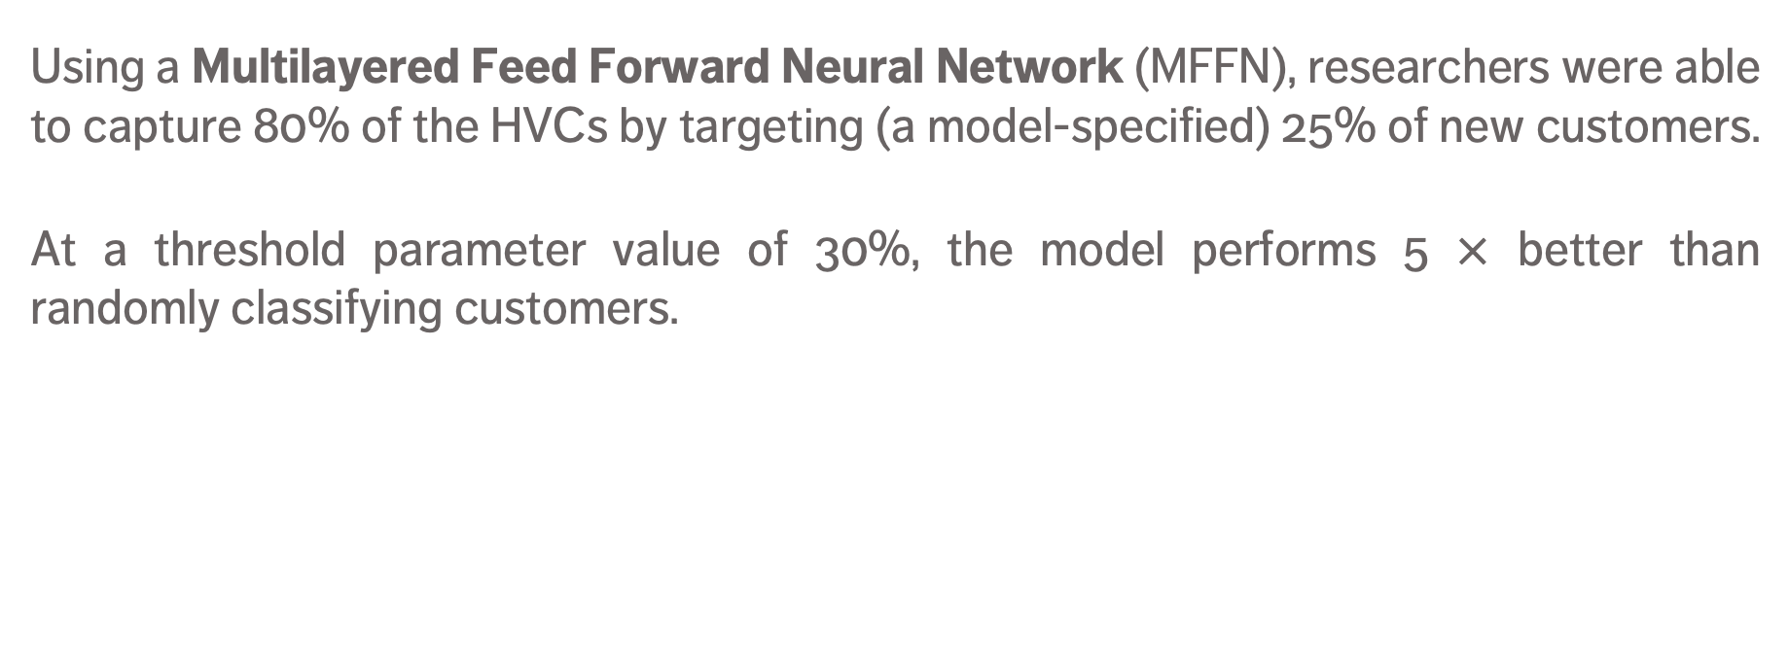
CASE STUDY: JAPANESE PHARMACY – Results
Using a Multilayered Feed Forward Neural Network (MFFN), researchers were able to capture 80% of the HVCs by targeting (a model-specified) 25% of new customers.
At a threshold parameter value of 30%, the model performs 5 $×$ better than randomly classifying customers.
Dataset | Training | Validation
Predictive Accuracy | 55.6% | 57.4%
Overall Accuracy | 90.6% | 91.2%
% Classified as HVC | 10.6% | 10.3%

Slide 26
Deep Learning Networks
Deep Learning networks are simply ANNs with a large number of hidden layers (and various types of nodes)
Types:
Convolution Neural Networks Handwritten digit recognition, 99.7% accuracy in 2013, Self-driving cars
Recurrent Neural Networks Natural language processing (speech recognition, machine translation, etc.)
Autoencoders
Restricted Boltzmann Machines BellKor’s Pragmatic Chaos, Netflix Prize, 2009

Slide 27
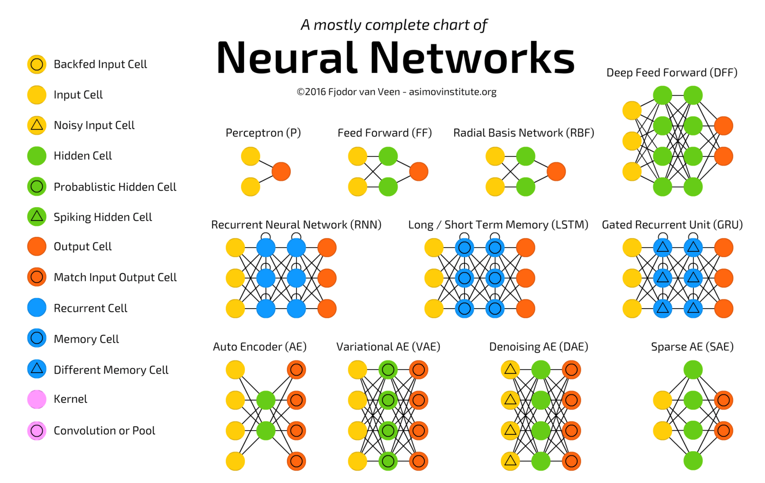
[Fjodor van Veen, Asimov Institute, 2016]

Slide 28
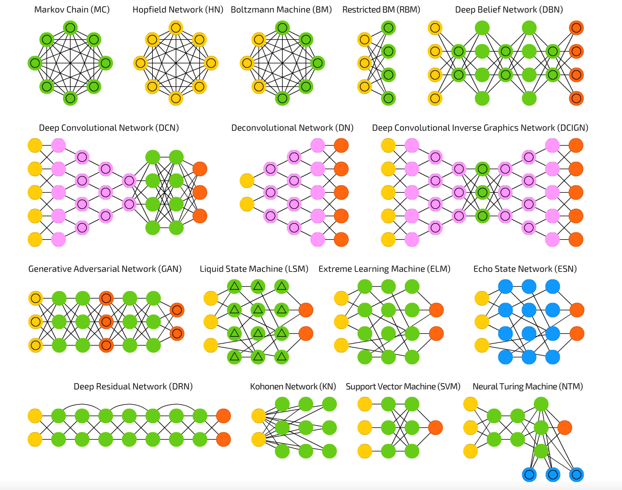
[Fjodor van Veen, Asimov Institute, 2016]

Slide 29
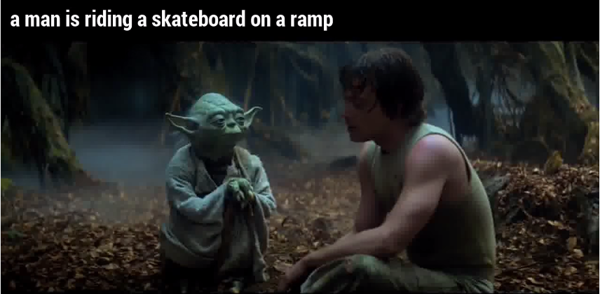
Limitations
[@samim, medium.com]
Require large, diverse, and correctly labeled training sets.
Accurate on average, but they can still be spectacularly wrong.
They can be “hacked” (NFL).
Humans don’t need that much labeled data to make decisions: so what’s really going on under the hood? (3rd AI Winter?)

